Slide 1
Interactive Physics-Based Animation – Part 1
Pauline Belford

Slide 2
Introduction
Rigidbodies
Kinematics
Discrete vs. Continuous Motion
Tunnel Effect
Collision Detection
Update vs Fixed Update
Responding to Events
Responding to Triggers

Slide 3
Rigidbodies
Game objects, by default, do not behave according to the laws of physics.
They’re just objects tangible in the world.
They have a mesh, usually, which defines their form.
But Unity, unless specifically told otherwise, will treat them just as set dressing.
In order to make them work sensibly, we need to make them rigid.
Which we do with the application of a Rigidbody component.
Rigid bodies provide the necessary hooks to allow an object to obey forces applied to it.

Slide 4
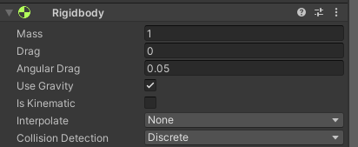
Rigidbodies
The cubes (and other random shapes) in our 101 demo were able to rotate though each other, and to float in space.
This is because we have not made use of colliders, rigidbodies, or triggers.
Our Rigidbody component lets us give the object various physical properties including mass and drag.
These enable the objects to respond to Forces and Torques.
A force applies a “shove” in a particular direction.
A torque applies a “rotation” in a particular direction.
The Rigidbody component also allows us to choose the type of Collision Detection we want to use.
More on this later.
Notes:
Mass – the amount of matter the object has. When we multiply it by the acceleration of gravity we get the Weight of the object.
Drag – a force that affects positional movement. Drag acts opposite to the relative motion of the object moving with respect to the surrounding air or fluid surrounding it. Like trying to cycle into the wind. The stronger the wind, the more your speed is curtailed.
Angular Drag – drag which applies to rotational movement of an object. The higher the value, the quicker the object’s rotation will come to rest following a collision or torque.
Gravity – The force that pulls objects towards the ground.

Slide 5
Rigidbodies
Let’s add a Rigidbody component to our Cube prefab from the Unity 101 Demo.
What happens?
Why?
How can we change that without removing the rigidbody?

Slide 6
Rigidbodies and Kinematic objects
If we uncheck Use Gravity, the cubes will not fall to the ground.
However, other forces can still affect them.
If we check Is Kinematic, then no forces will act upon the object.
So why apply a Rigidbody?
You may want to switch it on and off in scripts, giving you very easily controllable objects.
Notes:
Show the project with the sphere and cube. Called RigidbodiesAndKinematicsTest. With colliders but no rigidbodies, the sphere moves directly through the cube.
Add a rigidbody to the sphere but tick is kinematic – still moves through the cube.
Untick is kinematic. Now the OnCollisionEvent is triggered. Even though the cube does not have a rigidbody component. (Cube is destroyed.)
Comment out the OnCollisionEnter event. Now the sphere just bumps up against the cube.
Add a rigidbody to the cube too, and uncheck use gravity. Now the sphere pushes the box aside as you would expect , and applies a force to the box which results in it slowly continuing to move and rotate slowly after the sphere has moved on.

Slide 7
Colliders and Collision Detection
Types of Colliders
Issues with Collision Detection
Types of Collision Detection
Notes:
Collision Events only happen if at least one of the colliders has a non-kinematic rigidbody attached.

Slide 8
Collision Detection
To get physics-based movement for objects, we can use Rigidbody and Collider components, and use the OnCollisionEnter or OnCollisionExit methods.
This gives us an object that moves and collides realistically with other objects.
Most of the time.
Because of the way in which movement is handled in Unity (and other game engines) we can end up with problems.
The Tunnel Effect
Fast-moving objects can seem to tunnel through obstacles.

Slide 9
Linear Dynamics
In the real world, objects have continuous motion in continuous time.
At any specific millisecond, the object will have a position in space and time.
In a computer simulation, objects are redrawn every frame. Illusion of continuous motion.
They will be redrawn at a new location if they are in motion.
5 Simple Flipbook Animations! – YouTube
The space they have travelled through will not be checked for collisions with other objects.
Move too quickly, and the object can teleport through another object without any collision being detected.
Have too thin a barrier object, and the object can teleport through it without any collision being detected.

Slide 10
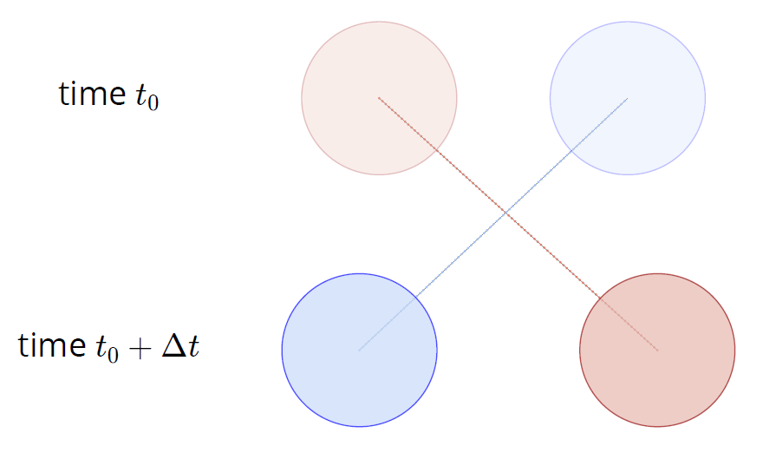
Tunnel Effect
The particles did not overlap at any point, resulting in a collision miss
Notes:
Go back to the example with the sphere and the cube.
Uncomment the OnCollisionEnter event so we can see it triggers at the default movement speed (-1 * DeltaTime).
Increase the speed by a factor of 5. The collision still occurs.
Increase the speed to -15 * Time.deltaTime. The collision does not occur.

Slide 11
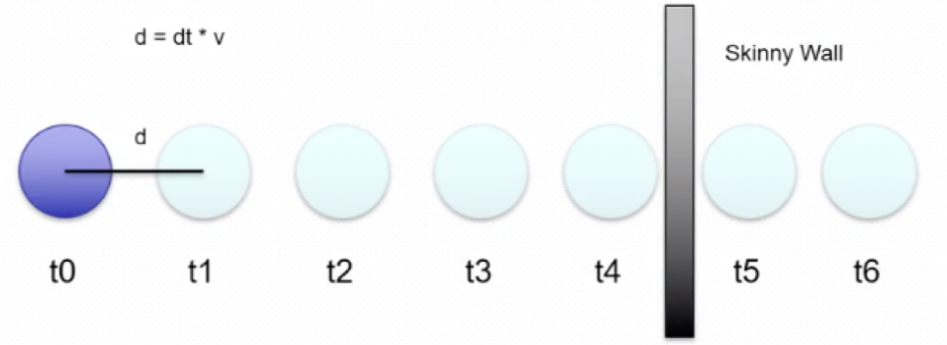
Tunnel Effect
Between time step 4 and time step 5 the sphere moves completely through the thin wall, essentially teleporting through it resulting in a collision miss.

Slide 12
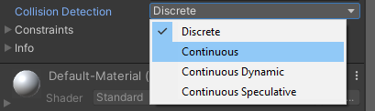
Preventing the Tunnel Effect
We could slow down the movement of the objects, to reduce the likelihood of tunnelling.
We could make objects larger, so that other objects have to travel a larger distance to get through them.
OR we can find a better collision detection option.
Unity uses Discrete Collision detection by default.
Discrete collision updates the collider position once per fixed frame, and detects collision between the overlapping colliders.

Slide 13
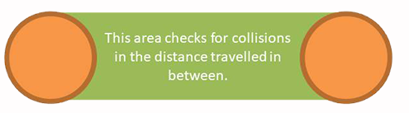
Continuous Collision Detection
Continuous collision detection utilises an algorithm that projects a shape across an object’s path of travel.
This shape can then be used to check for any collisions between each timestep.
The perfect solution to the tunnel effect?
It is significantly more computationally expensive.
Only use this for fast-moving objects.
Continuous collision detection is only used on static objects.
Tunnelling can theoretically still occur when colliding with another physics object.
Notes:
Static objects are ones which do not have a Rigidbody – so the object does not move using physics.
So, tunnelling can still occur when you are colliding with any other object that uses a Rigidbody component.

Slide 14
Continuous Collision Detection and Fixed Update
If we change our example program to use continuous collision detection for the sphere (the fast-moving object) will this solve our problem?
Not always.
We are currently placing the movement (transform) code in the Update method.
The Update method runs once per frame on every script.
Update is not called on a regular timeline – if the framerate slows, so does the frequency with which Update is called.
Unity has a FixedUpdate method which is called on a regular timeframe – every 0.02 seconds.
Immediately after FixedUpdate is called, any necessary physics calculations are made.
So, anything that affects physics objects should be done in FixedUpdate to ensure they sync up with the physics engine
Notes:
Let’s change our example program to use continuous collision detection.
Sometimes it works, sometimes it doesn’t. Why?
Tell them about the student project where the FPS game was so difficult I died within 3 seconds, and the best FPS playing students in the class couldn’t survive beyond 20 seconds. The student had mainly made the game on a very slow, old laptop. When transferred to our better computers for testing, the speed of action increased several hundred percent, making the enemies exceptionally fast.
FixedUpdate is called every physics step.
The FixedUpdate intervals are consistent.
Used for regular updates such as adjusting physics (Rigidbody) objects.

Slide 15
Continuous Dynamic and Continuous Speculative
Continuous Dynamic detection uses continuous collision against all objects except against rigidbody objects using Discrete collision detection.
So slow or non-moving objects must also use Continuous collision detection, or not have a Rigidbody component, or this still may not work.
Speculative Dynamic collides against everything
Static and dynamic objects in all modes of collision
This mode is computationally faster than the other 2 modes of collision detection.
Can also detect some kinds of collisions caused by spinning objects which are missed by continuous dynamic collision detection.
Why not use this for everything?
Because it predicts collisions based on objects’ current motions, it can inaccurately predict collisions before they happen.

Slide 16
Selecting the best collision detection method
Situation | Best solution
No fast-moving objects in game* | Use Discrete collision detection (CD) for all objects.
Collision accuracy unimportant | Use Continuous Speculative CD for fast-moving objects, and Discrete for other objects
Dynamic objects (with rigidbodies) which don’t encounter fast-moving objects | Use Discrete CD
Slow or non-moving dynamic objects where collision accuracy with fast-moving objects is important | Use Continuous CD
Dynamic objects that are fast-moving. | Use Continuous Dynamic CD
*Fast-moving means the object can travel further than it’s height or width within a frame.

Slide 17
Collision Detection Summary
CD Mode | Static | Discrete | Continuous | Continuous Dynamic | Continuous Speculative
Continuous | ü
Continuous Dynamic | ü |  | ü | ü
Continuous Speculative | ü | ü | ü | ü | ü

Slide 18
Collision Events
When a collision happens with a dynamic object, physics forces will be applied to the object.
We can also make other things happen through scripting, using the OnCollisionEnter and/ or OnCollisionExit events.
These methods run when a collision starts or ends.
We can use them to do various things:
Cause a particle effect to happen
Teleport the object to a different location
Destroy one or more of the objects involved in the collision
Many, many other possibilities.
Lets keep it simple for now, and change the example program so that the cube disappears when the sphere collides with it.

Slide 19
Collision Detection Script Example
public class MoveSphere : MonoBehaviour {
void Start() { }
void Update() { }
private void FixedUpdate() {
transform.position += new Vector3(-1 * Time.deltaTime, 0, 0);
}
//destroy anything the sphere collides with
void OnCollisionEnter(Collision col) {
Destroy(col.gameObject);
}
}

Slide 20
Triggers
Collision events are great when used for solid events, i.e. when physical objects collide.
Sometimes we want to trigger events when something invisible happens
Like triggering an alarm.
Or collecting a power-up.
Springing a trap.
Causing an enemy to be alerted to your presence.
Signalling the end of a race.
You want your vehicle to drive over the finish line, not collide with it.
For those types of events, we can use OnTriggerEnter and OnTriggerExit.
Rigidbodies are unaffected (in terms of physical forces) by triggers.
Don’t set an object as a trigger if you want it to display normal physical reactions to forces.

Slide 21
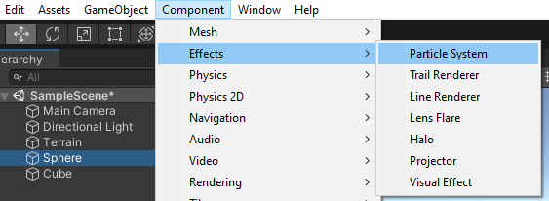
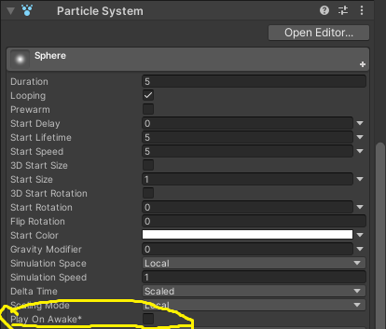
Trigger Event Example
Let’s set up a trigger that will start a particle effect when a sphere crosses a boundary.
We can do this by adding a cube to a scene and removing it’s mesh render, making it invisible.
Ensure it has a Box Collider, and tick the is Trigger box.
Add a sphere, add a Rigidbody component, uncheck use Gravity, and put code to move it in a script in the FixedUpdate method.
Attach a particle system to the sphere and uncheck Play On Awake.

Slide 22
Trigger Event Example Code
void FixedUpdate() {
transform.position += new Vector3(-1 * Time.deltaTime, 0, 0);
}
private void OnTriggerEnter(Collider other) {
GetComponent<ParticleSystem>().Play();
}

Slide 23
Summary and Task
In this presentation we have covered the following:
Rigidbodies
Discrete vs continuous motion
Colliders
Triggers
Collision Events
Trigger Events
Particle Systems
Based on this and the Introductory presentation, you are now ready to create your first Unity game, the Pachinko machine.

